Slide 1
An Approach to Evaluate and Measure Quality among Multiple Alignments
By
Faisal Ahmed
Reg. No.: 2011331047
Supervisor:
Biswapriyo Chakrabarty
Lecturer, CSE, SUST
Co-Advisors:
Md. Ruhul Amin Shajib
Assistant Professor, CSE, SUST
Md. Eamin Rahman
Assistant Professor, CSE, SUST

Slide 2
What is Sequence Alignment
A sequence alignment is a way of arranging the sequences of DNA, RNA, or protein to identify regions of similarity that may be a consequence of functional, structural, or evolutionary relationships between the sequences.

Slide 3
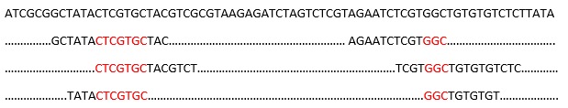
Reference Genome
Short Reads
Common Area Coverages

Slide 4
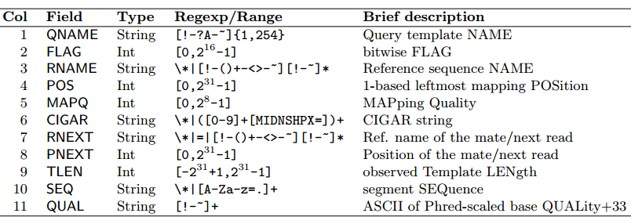
Sequence Alignment Mapping File Format Specifications

Slide 5
Tools To Evaluate SAM Files
Qualimap
IGV (Integrated Genome Viewer)
Picard tools
RNA-SeQC
RSeQC

Slide 6
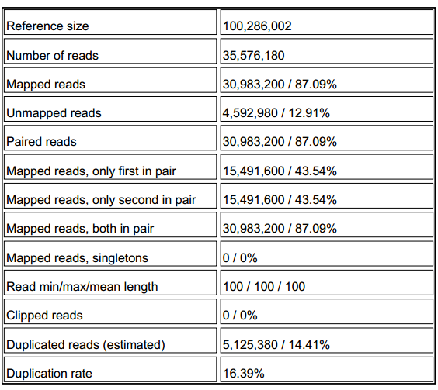
Qualimap Output

Slide 7
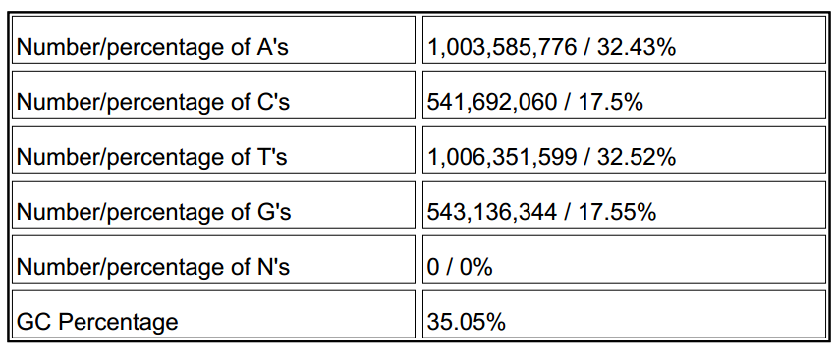
Qualimap Output

Slide 8
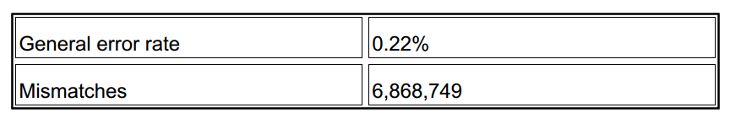
Qualimap Output

Slide 9
Sequence Alignment
Global Alignment
Local Alignment

Slide 10
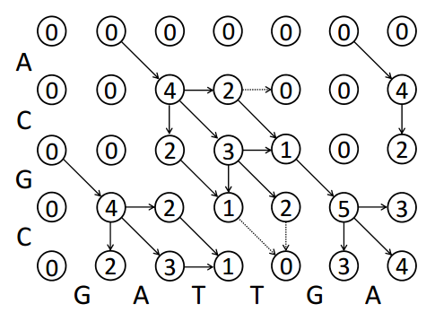
The Smith-Waterman Algorithm

Slide 11
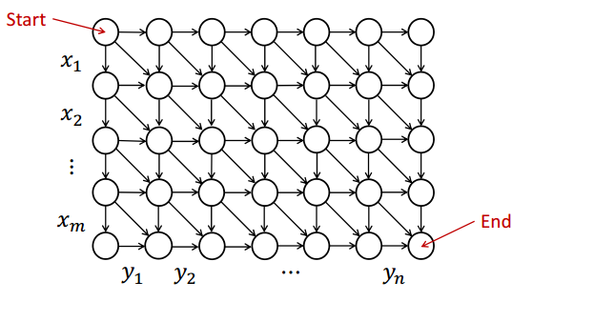
Path Graph

Slide 12
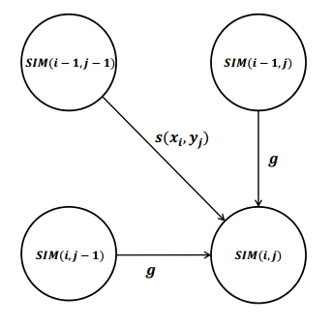
DP to Path Graph

Slide 13
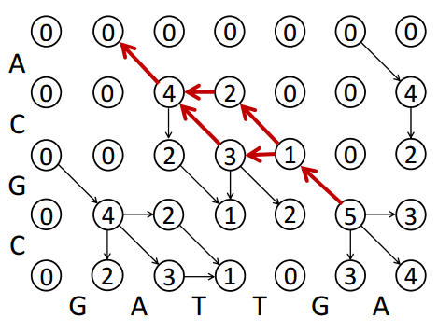
Global Alignment (TraceBack)

Slide 14
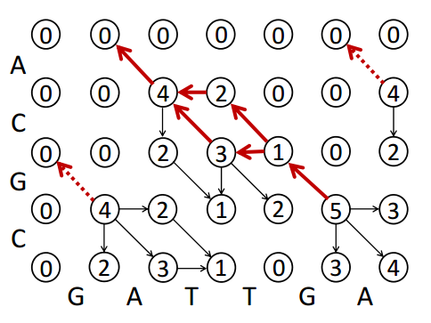
Local Alignment (TraceBack)

Slide 15
Scale Measurement Definition
Percentage of Identity means Percentage of Matches considering all penalties (insertion, deletion, mismatches)
POI = Total number of matches/ (Total Matches + Total Penalties)

Slide 16
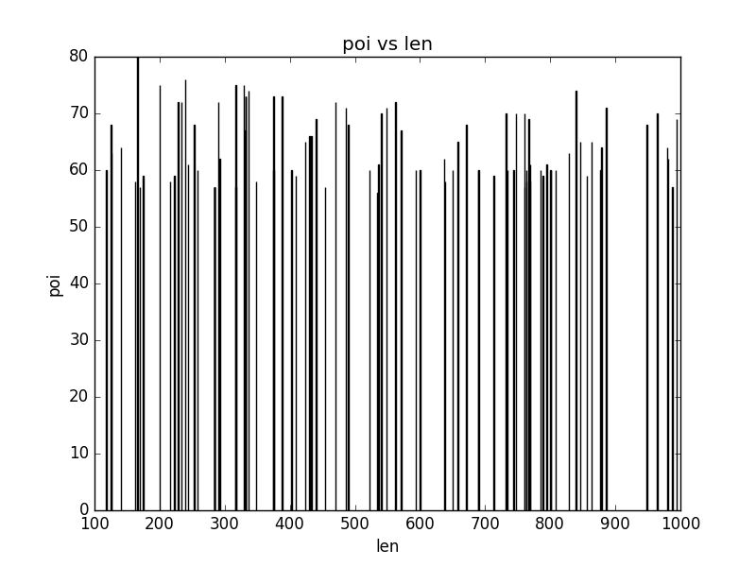
Max POI vs. Len

Slide 17
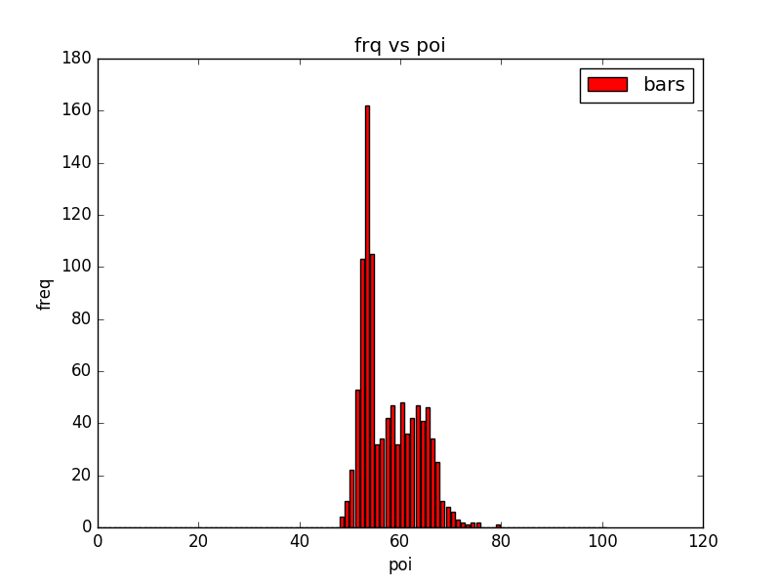
Frequency vs. POI (Global Alignment)

Slide 18
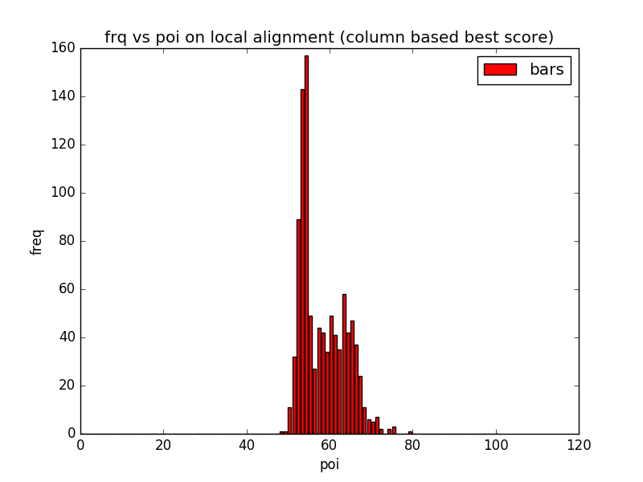
Local Alignment (Considering Column)

Slide 19
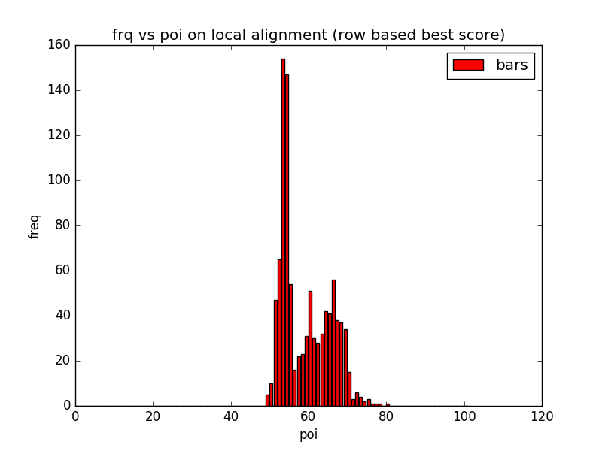
Local Alignment (Considering Row)

Slide 20
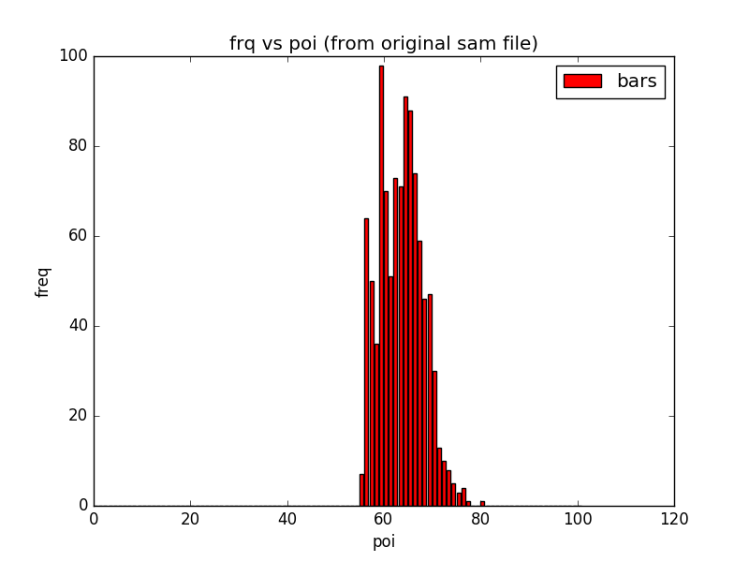
Freq. vs. POI (from original Input Data)

Slide 21
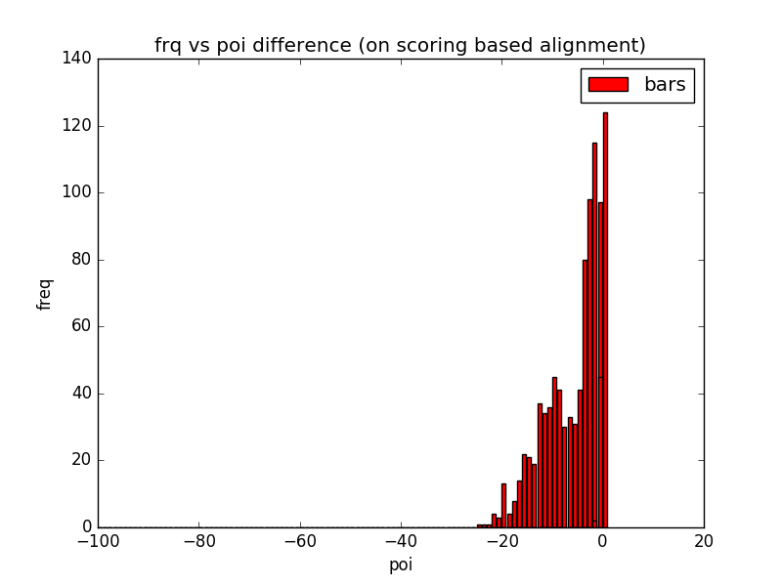
Difference with Implemented Global Alignment

Slide 22
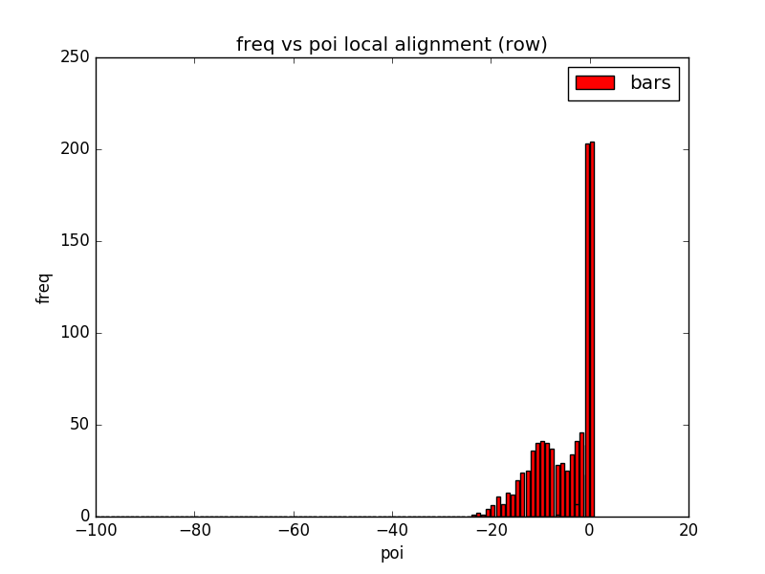
Difference with Implemented Local Alignment

Slide 23
Future Work
Optimization in the implemented naive algorithm
More analysis on making better alignment
Building memory optimized quality measurement and comparison tool

Slide 24
Questions…

